Slide 1

Week 4 Workshop:
Structural Biology

Slide 2
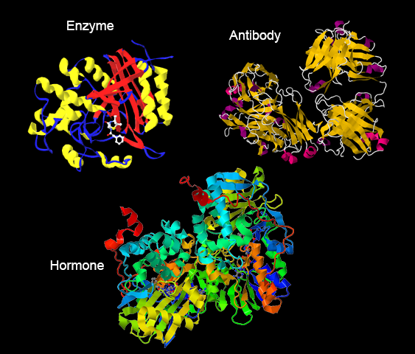
What are Proteins
Large molecules that play critical roles in biological processes in living organisms.

Slide 3
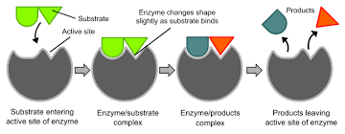
Why is it important to know what proteins look like
FORM = FUNCTION
Understand how proteins interact with molecules and the role they play in pathways by understanding their specific form

Slide 4
Why is it important to know what proteins look like
Understanding a protein's structure can help us in a variety of ways…
Role in Diseases & Drug Discovery:
Better understand what happens to proteins affected by disease, and develop drugs that counteract that
Understanding Evolution:
Comparing like proteins across species and time can help us understand

Slide 5
Background on Protein Structure

Slide 6
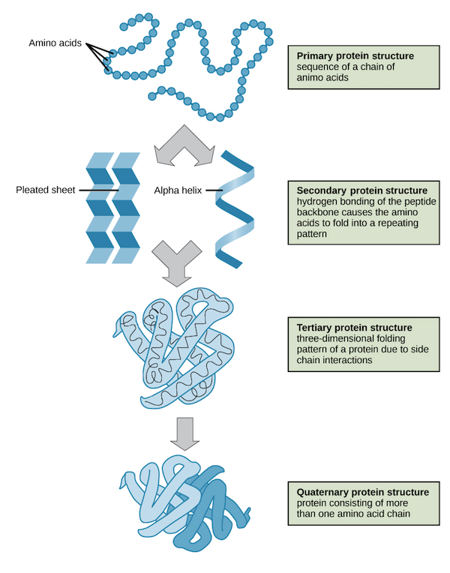
What Does Protein Structure Look Like
Primary: Amino acid sequence
Secondary: α-helices and β-sheets
Tertiary: 3D folding of one chain
Quaternary: Interaction of multiple chains
Notes:
Proteins are built hierarchically:
The primary structure is the sequence of amino acids linked by peptide bonds.
The secondary structure forms through local hydrogen bonds, creating repetitive patterns like α-helices (spirals) and β-sheets (flat sheets).
The tertiary structure refers to the overall 3D shape of the folded chain, influenced by side chain interactions and stabilized by bonds.
Some proteins are composed of multiple chains working together, forming the quaternary structure. Each level of organization is critical for the protein's function.

Slide 7
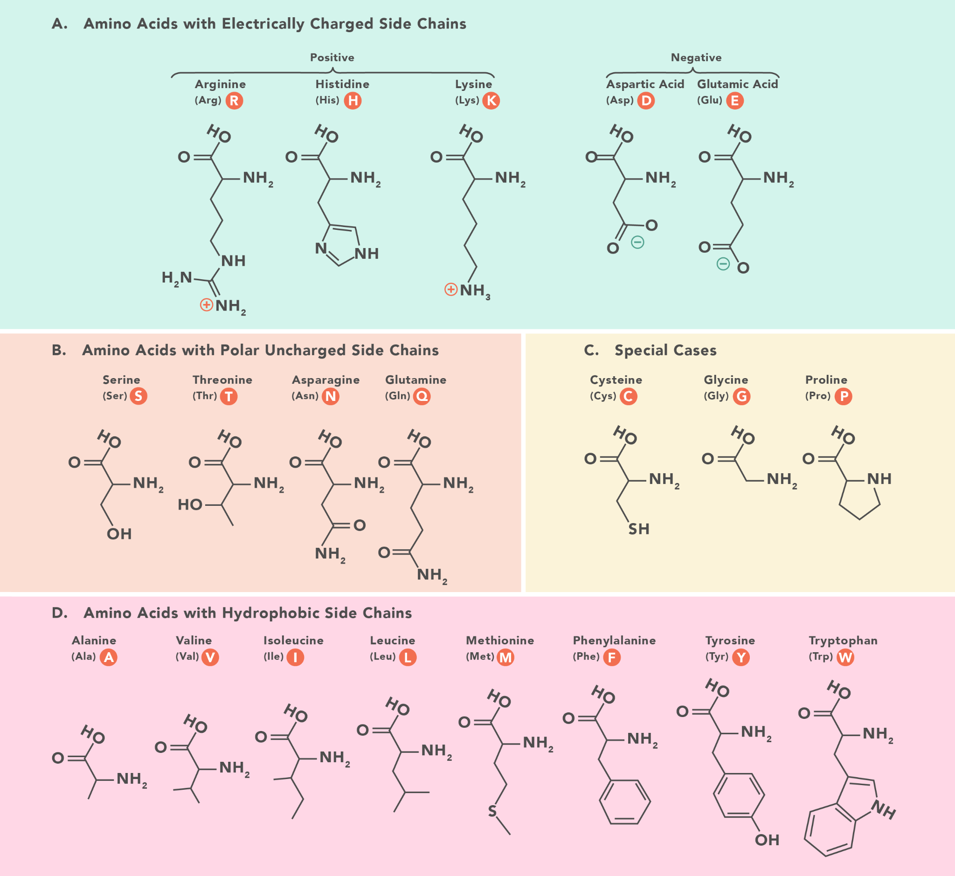
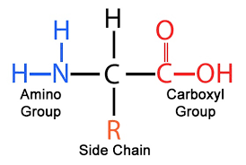
Amino Acids

Slide 8
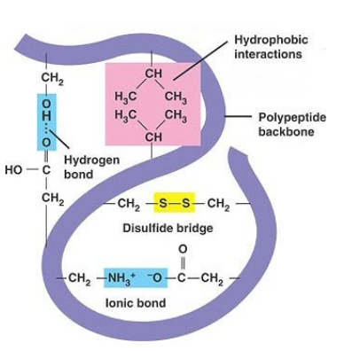
What Influences How Proteins Fold?
Folding influenced by:
Hydrophobic interactions
Hydrogen bonds
Ionic bonds
Disulfide bridges
Van der Waals forces
Notes:
Protein folding occurs because of interactions between amino acid side chains (R-groups) and the environment:
Hydrophobic interactions: Nonpolar R-groups avoid water, collapsing the protein inward.
Hydrogen bonds: Stabilize secondary structures and 3D folding.
Ionic bonds: Form between oppositely charged R-groups, creating strong attractions.
Disulfide bridges: Covalent bonds between cysteine residues, reinforcing structure.
Van der Waals forces: Weak attractions between atoms in close proximity.
Together, these forces guide the protein into its most stable, functional shape, balancing energy and structure.

Slide 9
Methods for Protein Structure Determination

Slide 10
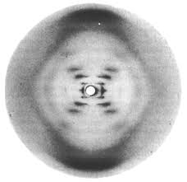
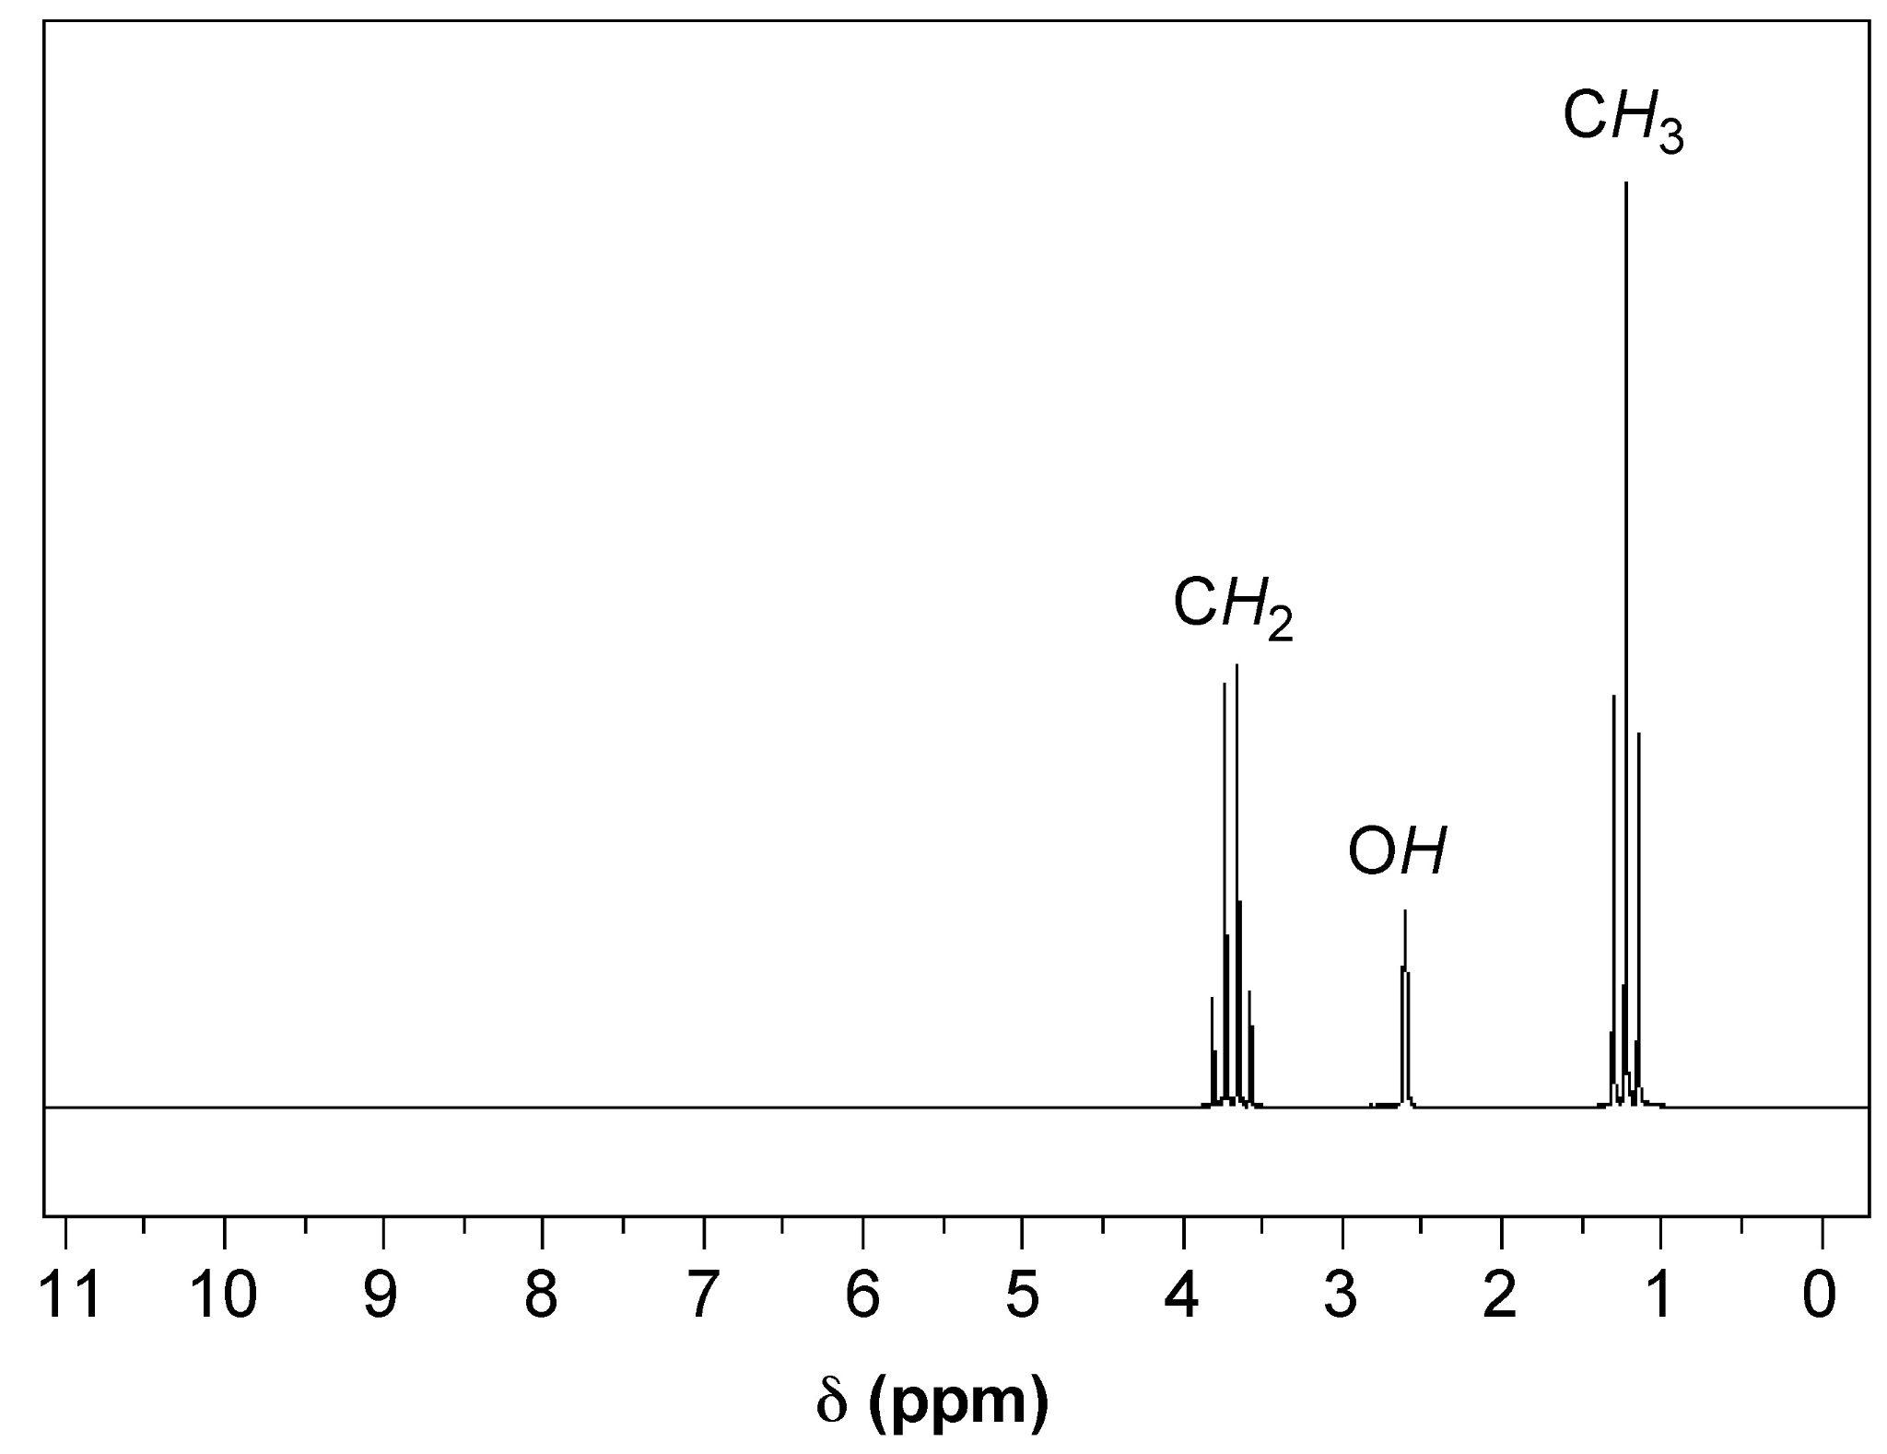
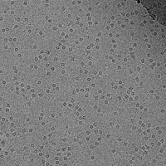
Analytical Techniques for Structural Biology
X ray crystallography
NMR spectroscopy
Cryo EM

Slide 11
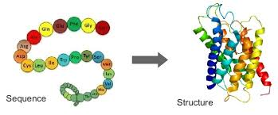
“The Protein Problem”
These methods are time and labor consuming, and require a lot of preparation in collecting materials, and work into refining the results
Much easier to know the sequences of these proteins than its 3D structure
So determine the structure of the protein based on the sequence?
NOT AS EASY AS IT SOUNDS
?

Slide 12
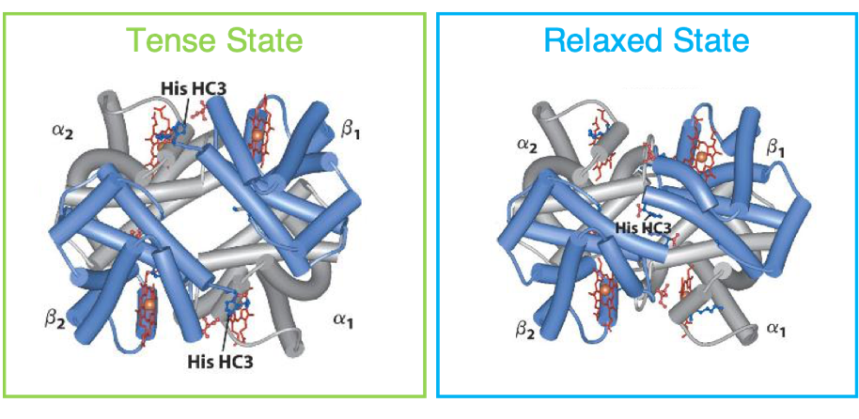
“The Protein Problem”
Proteins fold in very complex ways that rely more factors than just the peptides that make up its sequence:
structure affected by number of internal and external forces, including hydrogen bonding, hydrophobic interaction, dimers, electrostatic interactions, van der Waals forces, environment, etc.
Protein can fold in many different ways along an energy landscape, when created they follow the lowest energy landscape, but this can be hard to find
Proteins can take on a number of different conformations depending on their role, predicting this dynamic behavior can be difficult
Taking into account all these factors becomes very computationally expensive!

Slide 13
Ab Initio Modeling and Comparative Modeling
Use shortcuts to work around this problem!
Ab initio modeling
Uses sequence and nothing else to predict structure
Limited with how long of a protein sequence it can handle
Very time consuming
Methods:
QUARK
PEPFOLD2
3dProFold
Comparative modeling
Uses known similar protein structures to predict structure
Narrows down structure quicker
Gains inaccuracies of being limited to template
Methods:
MODELLER
SWISS-MODEL

Slide 14
AlphaFold

Slide 15
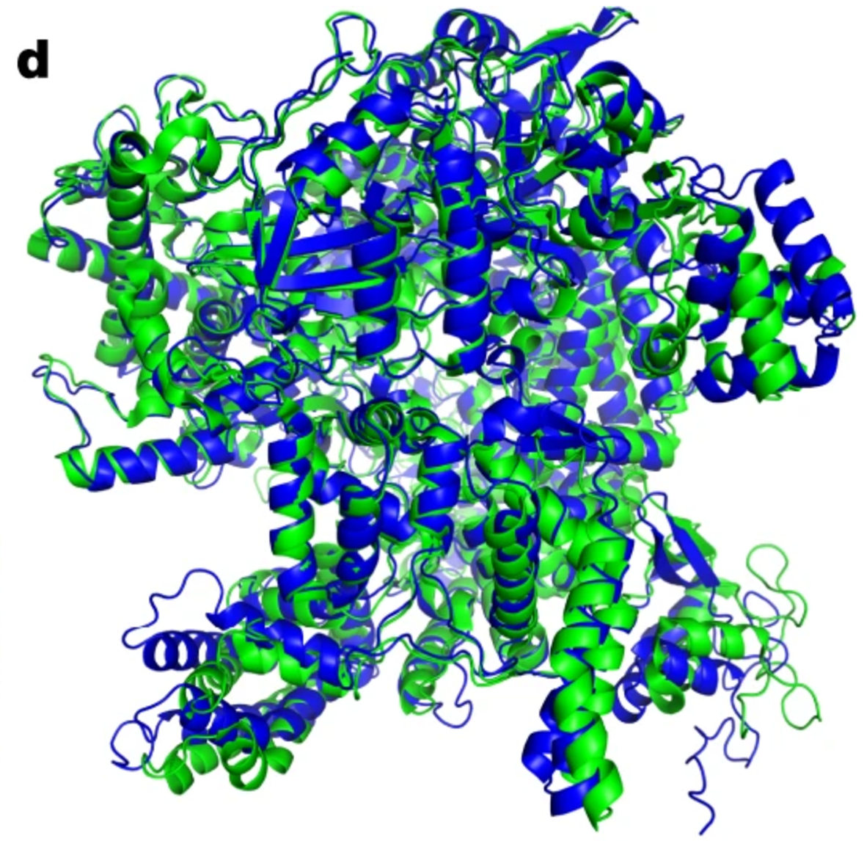
What is AlphaFold
AI system developed by Google DeepMind
Predicts protein’s 3D structure from amino acid sequence
Over 200 million entries - broad coverage of UniProt
Won 2024 chemistry Nobel prize

Slide 16
What is AlphaFold
Solved the “protein folding problem”
High accuracy
93% of side chains correct, 80% perfect fit
Accelerates research in biotechnology
Allows for targeted drugs discovery

Slide 17
What is AlphaFold
AlphaFold 1
AlphaFold 2
AlphaFold 3
Introduced a novel approach to protein folding using machine learning
Incorporated attention-based neural network causing increased accuracy
Modeled structures and interactions of proteins with DNA, RNA, ligands and ions

Slide 18

Machine Learning Overview
Training
Evaluation
Inference
Different types of learning: vary the usage of labeled / unlabeled data for training
Notes:
Training - Give the model some data, allow it to extract important parts of the data, process the data and determine the differences between its prediction and true value
Evaluation - Give a new dataset (validation/test set) to see how accurate it is
Measures how accurate, precise, error prone the task is
Inference - Apply to real world scenarios
Types of ML Models - Can learn from labeled data, find patterns in unlabeled, combine both, or even interact + give it rewards as appropriate

Slide 19
ML Applied to Protein Structure Determination
Type of AI/ML System for predicting protein tertiary structures
Workflow
Sequence Input
Alignment
Neural Network Predictions
Refinement
Primarily Advantage - speed, compared to experimental determination methods
Notes:
Takes in an amino acid
MSA - Find evolutionary relationships by aligning similar sequences across organisms
Prediction - Predicts relationships between amino acids, create a probability distribution of the possible results
Refinement - Optimize and refine the structure

Slide 20
AlphaFold Algorithm
https://www.youtube.com/watch?v=3gSy_yN9YBo - 12:00 min
https://www.youtube.com/watch?v=7q8Uw3rmXyE - 5::00 min

Slide 21
Achievements & Limitations
Achievements
Research everywhere heavily use AlphaFold to quickly determine protein structure
Efficient as an algorithm for also solving previously unknown protein folds
We have a comprehensive database of protein structures created by AlphaFold that people can use to validate their protein reconstructions
Limitations:
Affected by point mutations
Lower confidence with proteins that do not have similar known structures
Not designed to capture dynamic movement, but can get different conformations
Validating novel models created by AlphaFold

Slide 22
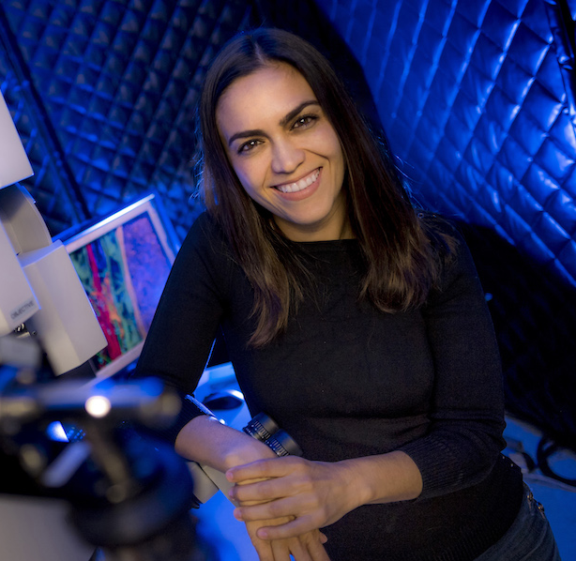
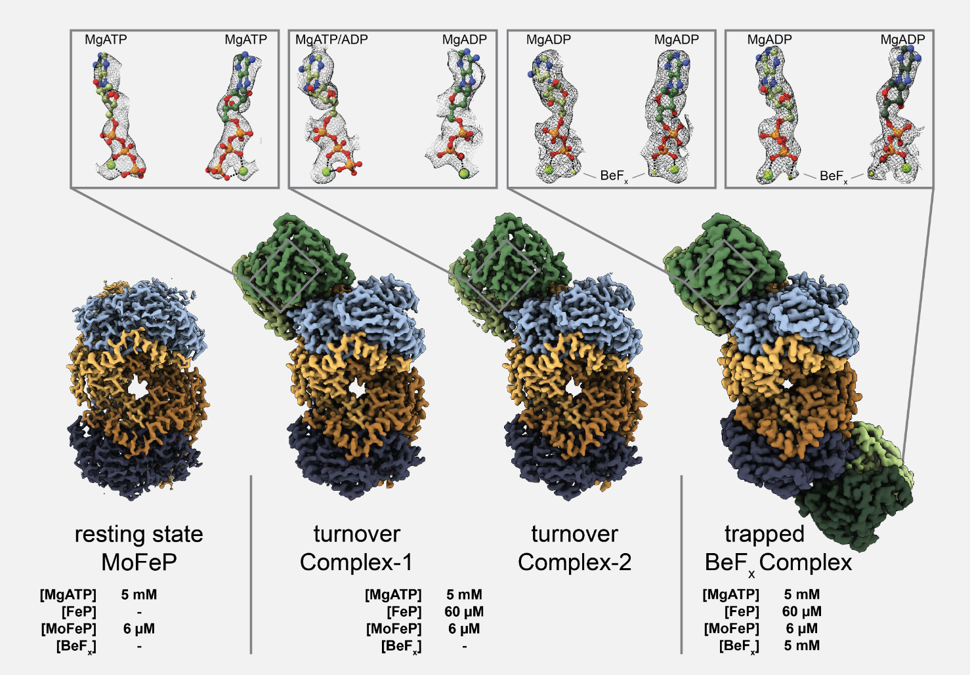
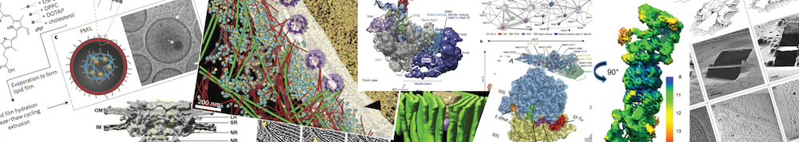
Labs at UCSD
Herzik Lab
Villa Lab
Notes:
Cryo-em for an atomic-level understanding of the structure and dynamics that govern macromolecular transport within eukaryotic cells
Cryo-electron microscopy and tomography, cell biophysics, computational analysis, and integrative modeling to help in the design of inhibitors, and to understand the mechanistic details of LRRK2 function in Parkinson's Disease

